Slide 1
Analysis of Cars Dataset
Linear Regression Model

Slide 2
Step 1: Identification of problem
Purely numerical values for buying price for a car were to be estimated from the given data.
Hence, it was evident that it was a regression problem and not a classification problem.

Slide 3
Step 2: Visualization
It was necessary to visualize how the different features where distributed.
The histograms for all the features using hist were plotted.

Slide 4
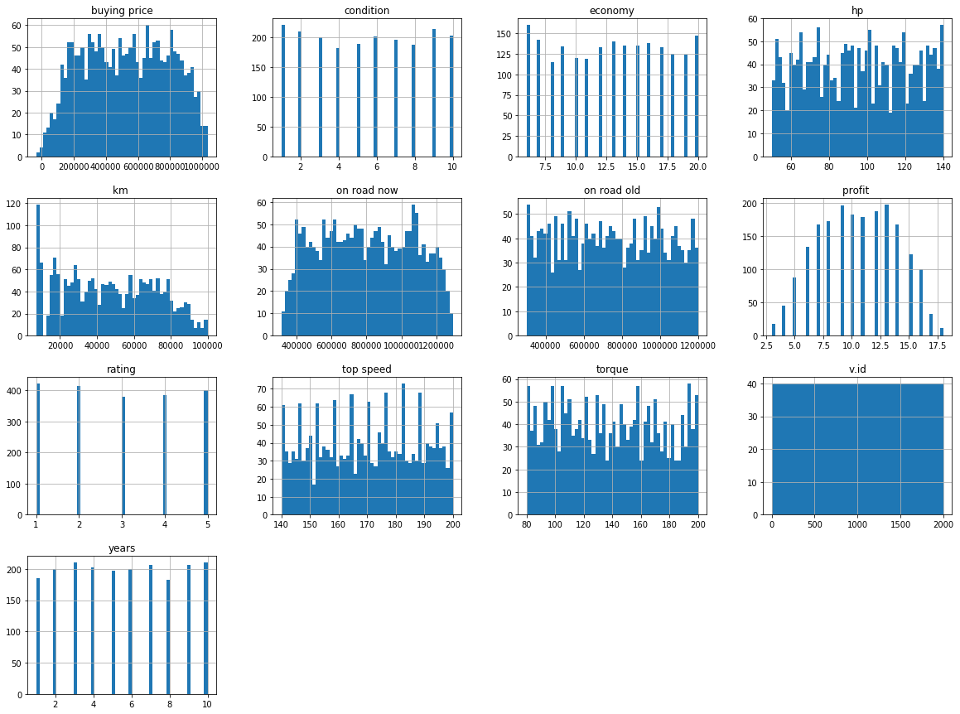
train.hist(bins=50, figsize=(20,15))
plt.show()

Slide 5
Observation
The on road old and on road new seemed to be the most correlated with the buying price.
Most other features were evenly distributed.

Slide 6
Step 3: Data preprocessing
Erroneous data from the table was eliminated by dropping the rows with incorrect data.
For example, dropping rows with negative buying price values.

Slide 7
Step 4: Confirmation of Correlation
The buying price attribute had to be correlated with one or more features.
By plotting the correlation using scatter_matrix, the following result was obtained.

Slide 8
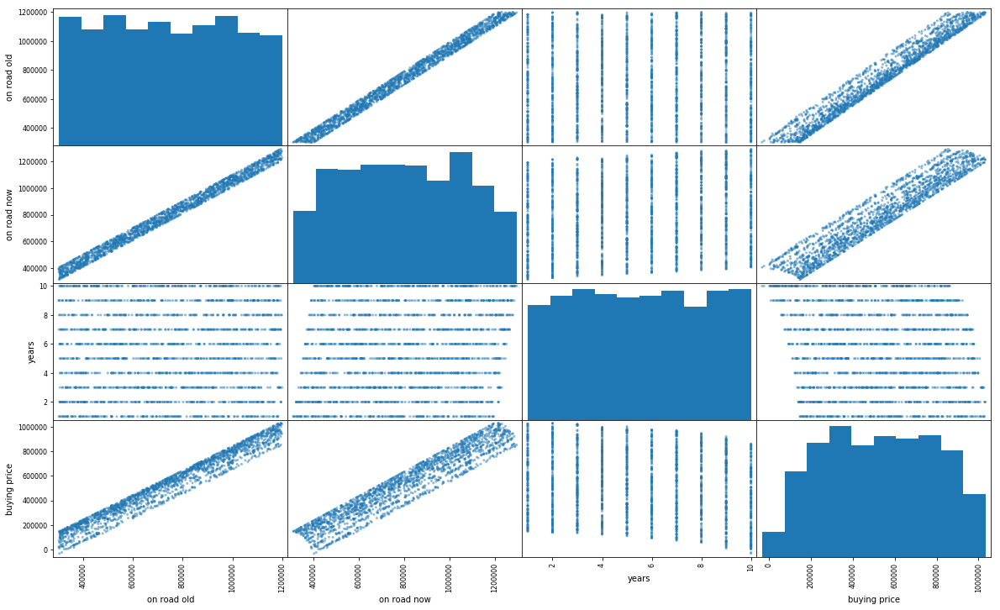
from pandas.tools.plotting import scatter_matrix
attributes = ["on road old", "on road now", "years", "buying price"]
scatter_matrix(train[attributes], figsize=(20,12))

Slide 9
Observation
The ‘on road now’ and ‘on road old’ features were very well correlated with the buying price.
The ‘years’ feature showed some sort of correlation with the buying price.
That is, the buying price was slightly lesser for cars having more age.

Slide 10
Step 5: Linear Regression
The files were imported as data frames using pandas.
The required attributes were selected from the imported data frames.
These files were used to fit the regression variable.
It was then used to predict the output.

